Slide 1

IBM Accelerate
Virtual learning experience from June 3rd – July 24th, 2024
Welcome! We will get started in a few minutes.
Post in the chat where you are joining from tonight
& what you are most looking forward to this summer!

Slide 2


Welcome to the 2024 IBM Accelerate Program!

Slide 3

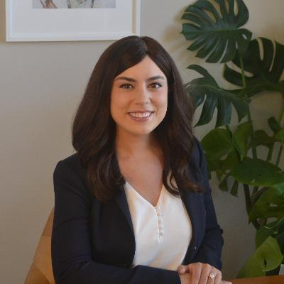
Carly Keller University Pipeline Program Manager Accelerate & North America Internship Columbus, OH Slack-- @carly.s.keller Email -- carly.keller@ibm.com

Slide 4


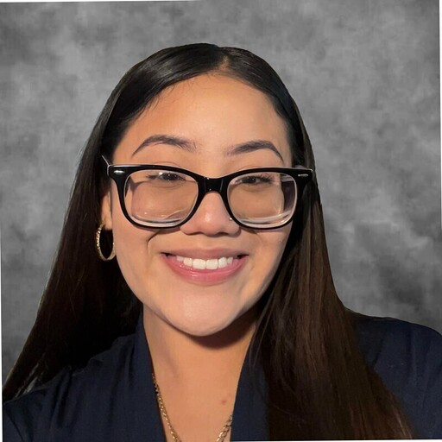
Accelerate Program Team
Dimitra Mourikes
Accelerate Program Manager
New York, NY
Slack @dimitra.mourikes
Adlaine (Addy) Andoh
University Pipeline Program Associate
New York, NY
Slack @adlaine.andoh
Vanessa Martinez
University Pipeline Program Co-Op
Austin, TX
Slack @vanessa.martinez
IBM Accelerate 2024

Slide 5

IBM Accelerate
Dayna Harper
CCEM Lead, CIO Mergers & Acquisitions
IBM
IBM Accelerate 2024

Slide 6
The Power of Pivot
IBM Accelerate 2024
Dayna T. Harper
Customer Contact Entitlement & Migration Lead
CIO - Business Development Mergers & Acquisitions
June 3, 2024
Foundational Skills Session: Week 1

Slide 7

















Life & Career Milestones
Still going & growing…
Customer Contact Entitlement & Migration Lead (CCEM) - 2023
Moved to Ohio - 2012
NOW
N.C. A&T State University
2010-12
Became a mom - 2023
SMOE English Teacher
선생님
CIO Internship Program Manager - 2022
Dayna T.
Harper
Moved to Seoul, SK- 2008
Director of Constituent Relations
2014 - 16
CIO Work Experience Lead - 2020
IBM | CIO | Business Development Mergers & Acquisitions | Career Map
Career Services & Student Success Coordinator - 2012-14
CIO - Business Development Mergers & Acquisitions
Customer Contact Entitlement & Migration Lead
Married my BFF
2015
Grambling State University 2004-06
Director of Student Affairs
2016
Location: Raleigh/Durham (RTP)
Moved back to NC
2016
Detroit, MI
native
START
Big Personal Events
Key Roles
Pivotal Career Moves
Key Recognition
Family
Challenge
Education
Key Advice
Opportunity

Slide 8

Proud Mom of The4HARPbeats
ONE-YEAR-OLD QUADRUPLETS
GRANT
Gentle Giant
Trying to Walk
30lbs
GAVIN
Mama’s baby
Reserved
Inquisitive
SYDNEY
Diva
Smile lights up a room
Independent
BAILEY
Free Spirit
True Baby Girl
Dare Devil

Slide 9



Please download and install the Slido app on all computers you use
What are your PERSONAL Summer 2024 plans?
ⓘ Start presenting to display the poll results on this slide.

Slide 10
“
The ability to pivot in your professional career is a valuable skill.
Whether you're looking to change industries, explore new opportunities, or adapt to evolving market trends, a successful professional pivot requires careful planning, determination, and a willingness to embrace change.
- Author
Foundational Skills Session
IBM Accelerate 2024

Slide 11
The benefits of pivoting
1
Assess your situation.
Pay attention to immediate and long-term needs.
(major change, financial challenges, life changes, etc.)
2
Keep your mind open to new opportunities.
Identify your transferable skills.
Lean on your LinkedIn network, mentorship, and beyond.
Maintain a community: above & below
Don’t get comfortable in the short term.
3
Positions you for your next Power Move
Growth mindset is necessary for pivoting.
In a growth mindset, people believe that their most basic abilities can be developed through dedication and hard work. (Dweck, 2015)
Pivot towards YOUR purpose.
Foundational Skills Session
IBM Accelerate 2024

Slide 12
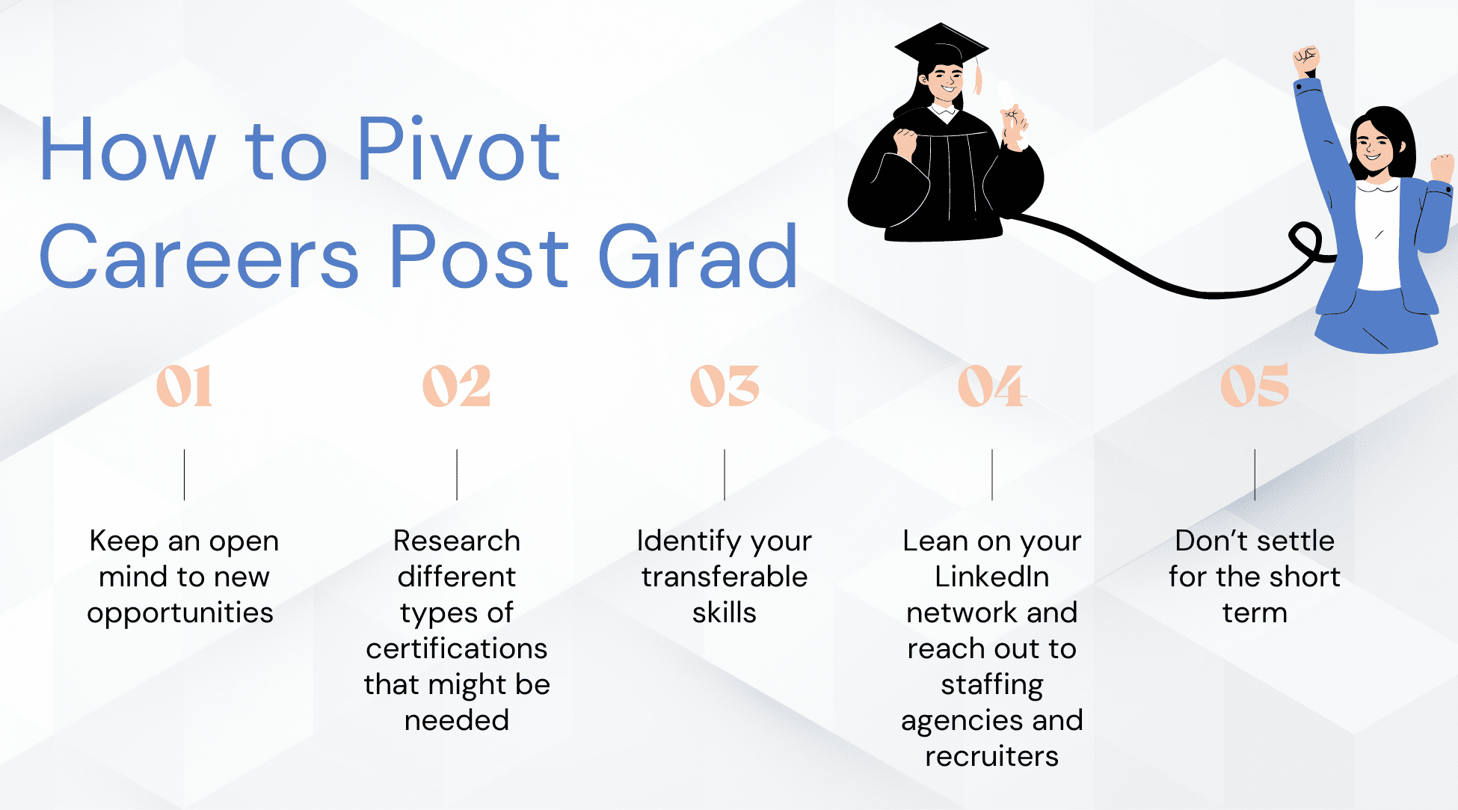
Things to Consider
Foundational Skills Session
IBM Accelerate 2024

Slide 13
Please download and install the Slido app on all computers you use
What are your PROFESSIONAL Summer 2024 plans?
ⓘ Start presenting to display the poll results on this slide.

Slide 14
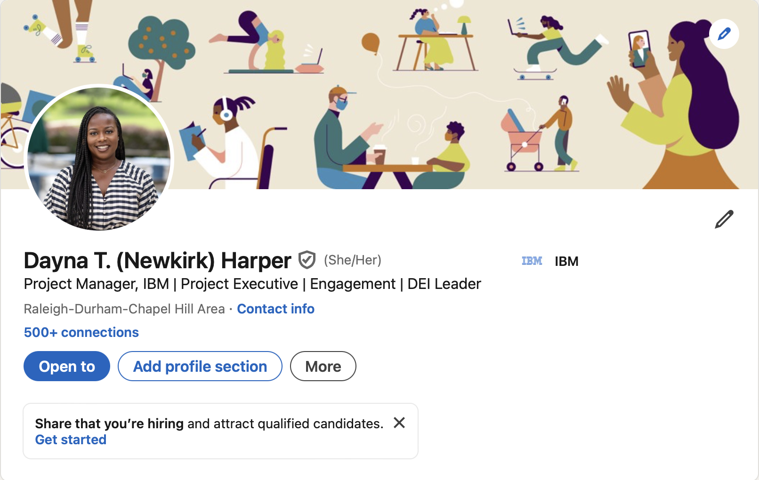
Let’s Connect!
Find me on LinkedIn
Email: dayna.harper@ibm.com
Foundational Skills Session
IBM Accelerate 2024

Slide 15
Questions?
Foundational Skills Session
IBM Accelerate 2024

Slide 16

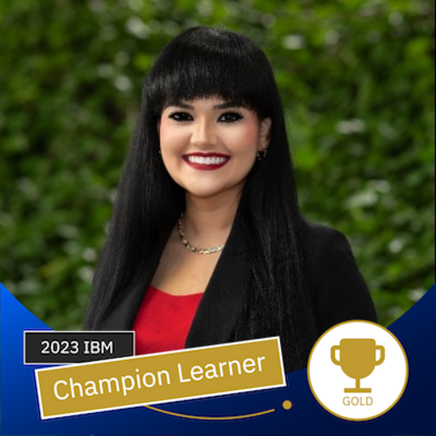



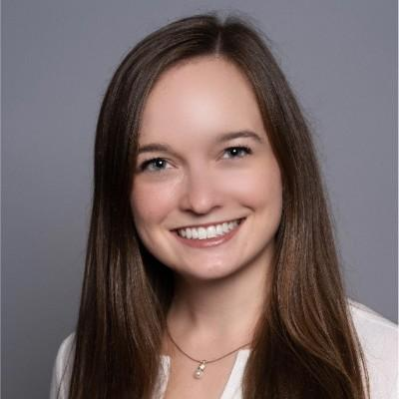
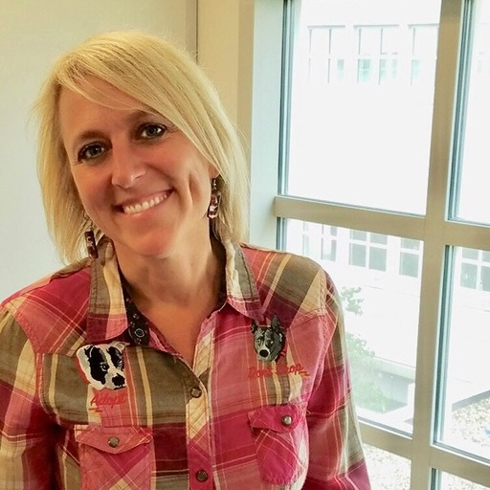

Wednesday Night Track Focals
Lana Soileau
Marketing & Communications
Sujeily Fonseca - Gonzalez
Software
Vanessa Hercules
Client Engineering & Technical Sales
Renee Albert
Brianna Snitchler
Design
Christina Albert
Consulting
Paula Bolender
Danille Jager
Research
IBM Accelerate 2024

Slide 17

Accelerate Participants
Representing 200+ colleges/universities!
Received 10,000+ applications this year
Your cohort is top 5%!
IBM Accelerate 2024

Slide 18








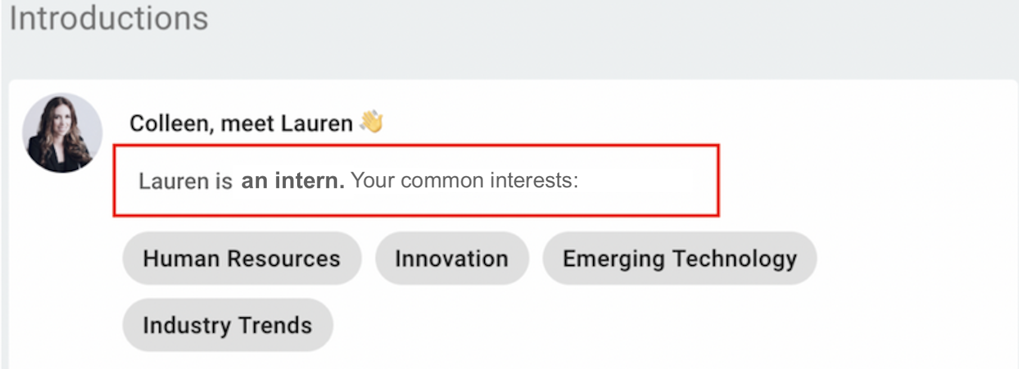



IBM Accelerate Program Networking Café (powered by Ten Thousand Coffees!)
What you need to know:
How It Works
Be on the lookout for
Introductions via Slack - you’ll receive networking introductions directly on Slack in #10kc-mainchannel-2024
Book your meetings via WebEx - we encourage you to be camera ready
Leave feedback after your experience - after your introduction, you’ll be asked to share feedback via Slack
We’ll use your goals/interests to match you 1:1 to peers & IBMers
Once you’ve been matched, you’ll receive an intro via Slack
Reply and coordinate time to meet your match right in Slack
After you’ve met, tell us about your experience via survey!
Slack Channels:
#10kc-mainchannel-2024
#ibm-accelerate-2024-participants
X
IBM Accelerate 2024

Slide 19
Slack Channels
Where to go to ask questions and stay updated!
#ibm-accelerate-2024-participants
#10kc-mainchannel-2024
#ibm-accelerate-2024-cets
#ibm-accelerate-2024-consulting
#ibm-accelerate-2024-design
#ibm-accelerate-2024-marketing
#ibm-accelerate-2024-research
#ibm-accelerate-2024-software
askaccelerate@ibm.com
Slack Code of Conduct
IBM Accelerate 2024

Slide 20
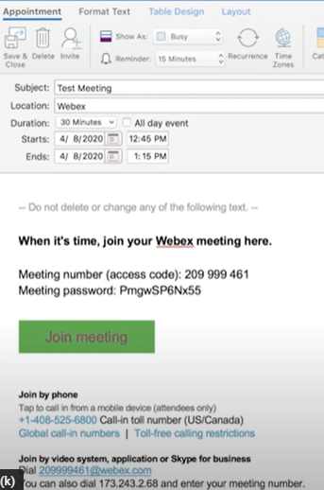
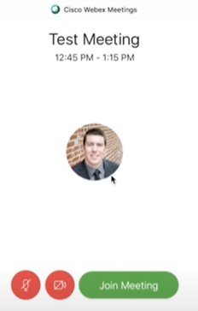
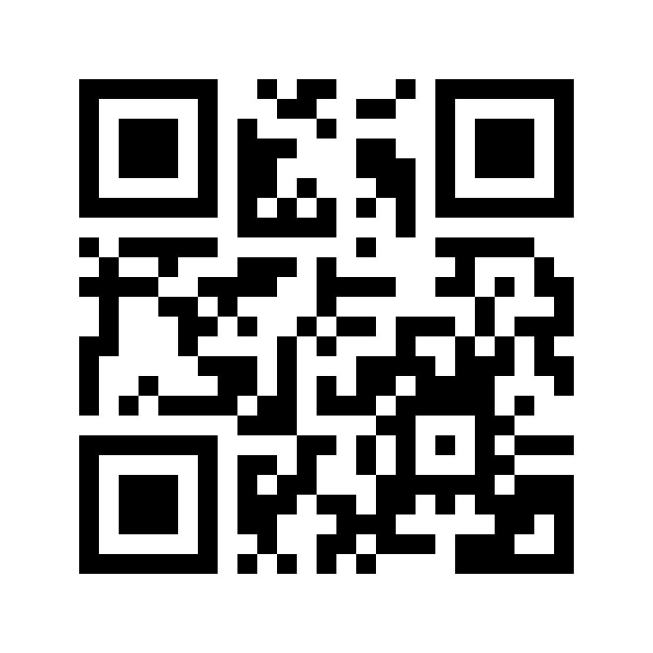
Attending Live Webex Sessions Joining Webex:
Find a well lit, quiet space with limited background activity and/or distractions
Join the virtual platform using the Webex link provided in the calendar invitation
Turn your camera ON
Be sure to MUTE
your microphone
A “How to join a Webex Video meeting” instructional video is available using this link https://ibm.biz/join_webex or QR code
microphone and camera controls
IBM Accelerate 2024

Slide 21
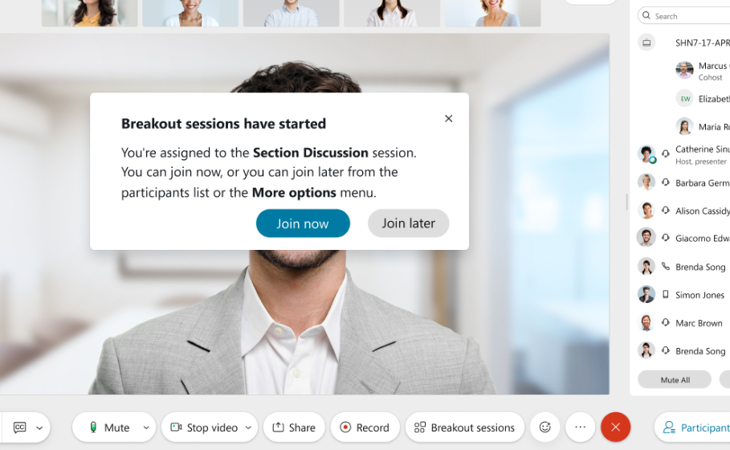
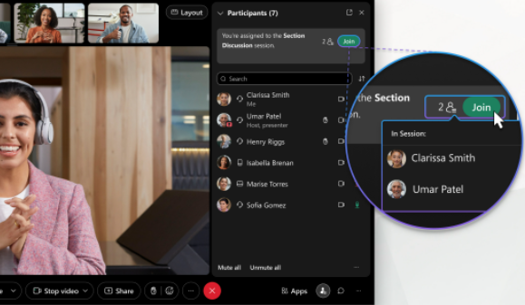
Joining a Breakout Session in Webex
To join a breakout session when it starts, click “Join now” in the message that appears
To join a Breakout Session after it’s in progress, go to the “Participants” panel and click “Join”
IBM Accelerate 2024

Slide 22
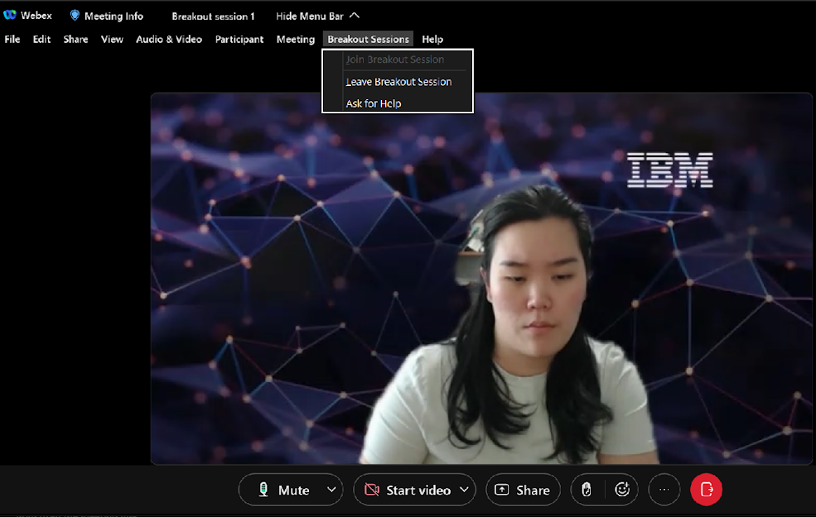
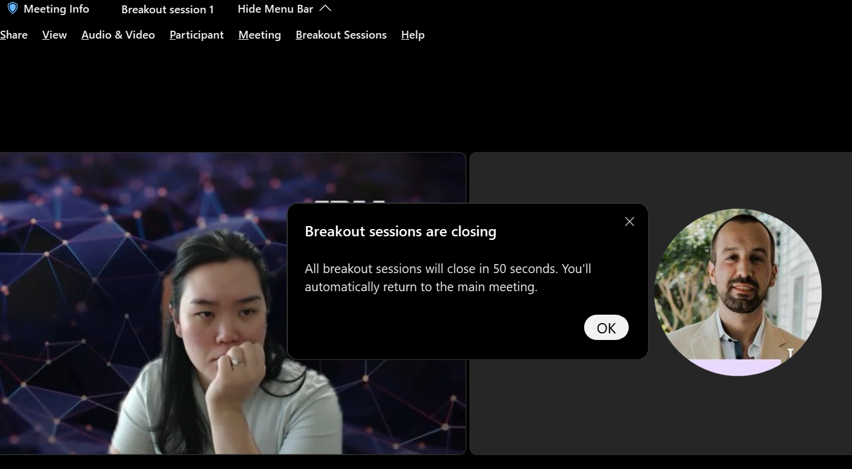
Leaving a Breakout Session in Webex
To leave a breakout session click “Breakout Sessions” and then click “Leave Breakout Session”.
The meeting host may close the breakout sessions to bring participants back to the main room. When the notification pops up, click “OK”.
IBM Accelerate 2024

Slide 23
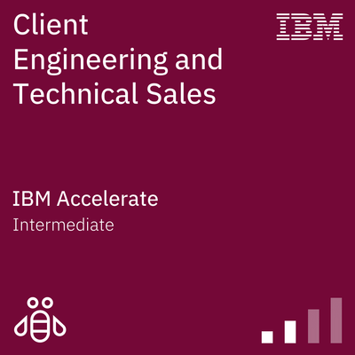
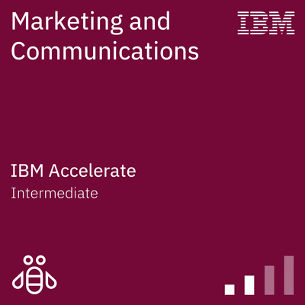
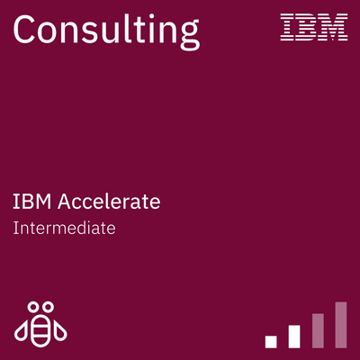
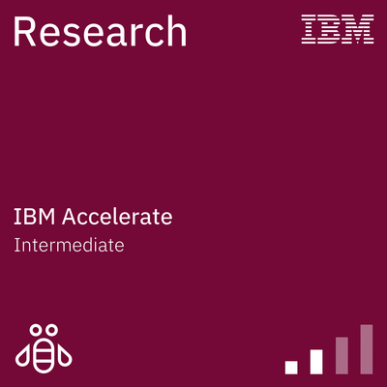
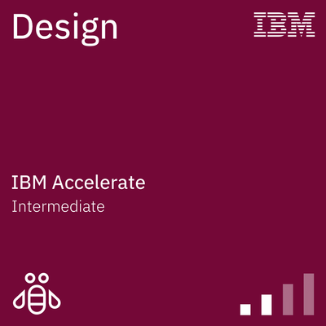
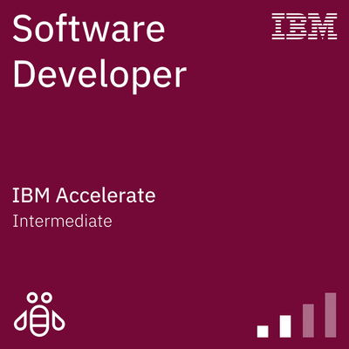
Earning an IBM Accelerate Badge
Attendance: IBM Accelerate participants may miss no more than a total of 1 track session and 1 foundational skills session over the course of the program.
Participation: Demonstrate engagement with the course material and ongoing skill progression through active participation in weekly sessions. Participation can be reflected in weekly quizzes or polls, commenting or asking questions during discussions, collaborating with peers in small group sessions, or taking advantage of optional networking opportunities.
Assessment: Badge earners must meet additional track-specific criteria as defined by the track to which they are aligned – you will learn more this Wednesday in your first track session.
IBM Accelerate 2023

Slide 24
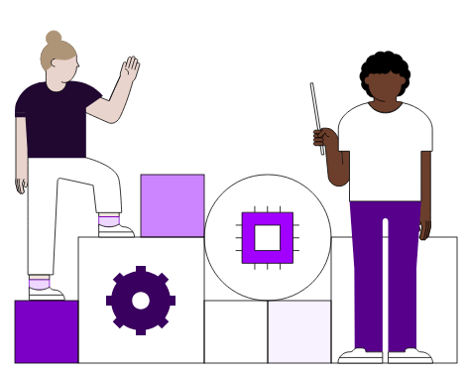
SkillsBuild
SkillsBuild is your source for free digital learning on industry-leading technology designed for you!
Follow the IBM Accelerate learning plan week by week to learn more about professional skills, mindfulness, and job applications. You can complete the modules at your own pace but we recommend doing so on a weekly basis, as each week correlates to our Foundational Skills Topics. Completing all of the assigned modules will earn you IBM SkillsBuild badges that you can share on your LinkedIn profile!
Enroll: https://sb-auth.skillsbuild.org/signup
Accelerate Learning Plan: https://skills.yourlearning.ibm.com/activity/PLAN-FAC31AAD379D
Roughly 2 hours of learning each week
18 total hours of learning
Explorations into Mindfulness Digital Badge
Job Application Essentials Digital Badge
IBM Accelerate 2024

Slide 25
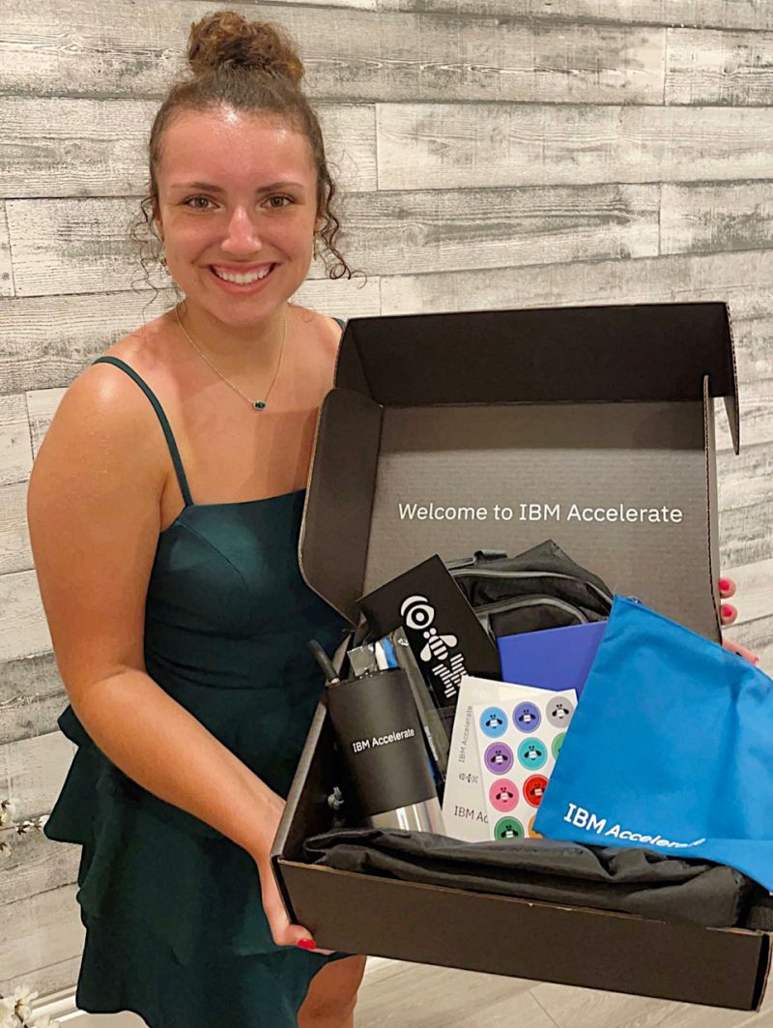
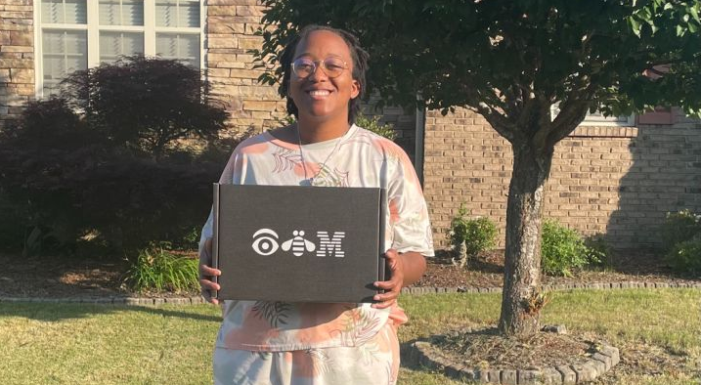

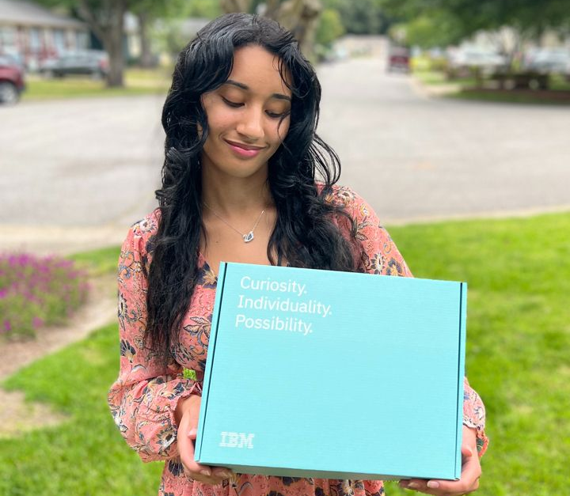
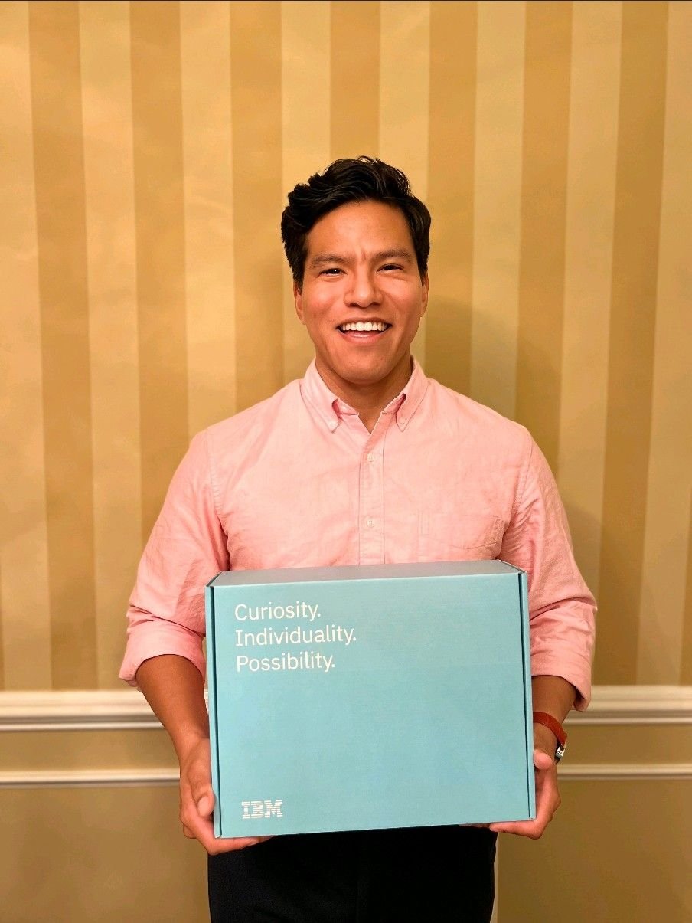
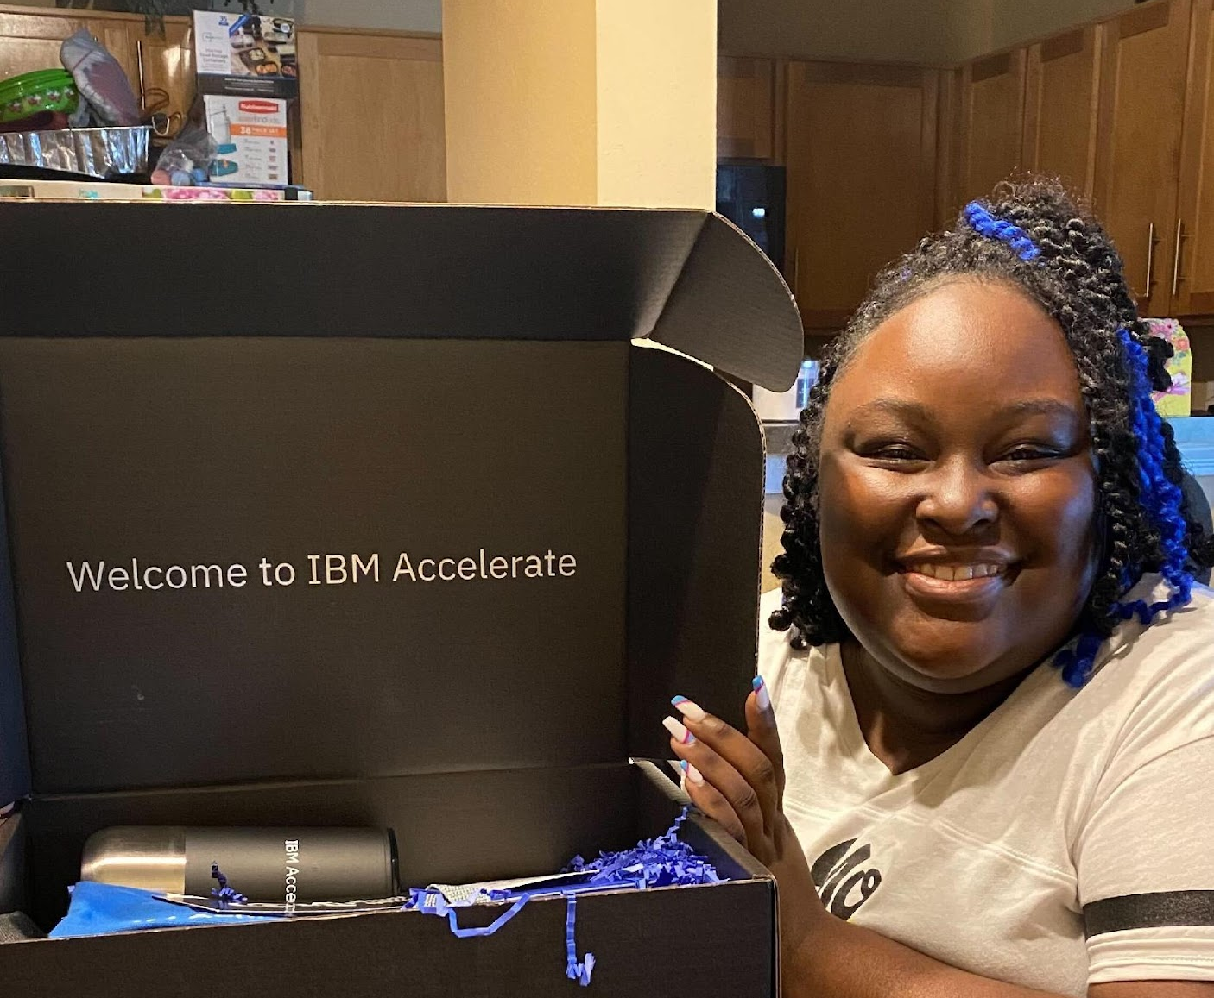
Swag!
You will receive an email to order your IBM Accelerate Program swag over the next 2 weeks!
Our team will send reminder messages over Slack
IBM Accelerate 2024

Slide 26





Let's get social!
Follow us!
Post on social channels using hashtag #IBMAccelerate and tags below!
Engage with us on social media and you might be featured in our Accelerate end of program video!
Note: General program reminders will also be sent around 3pm ET every Monday!
@LifeatIBM
@IBM
@Life at IBM
IBM Accelerate 2024

Slide 27
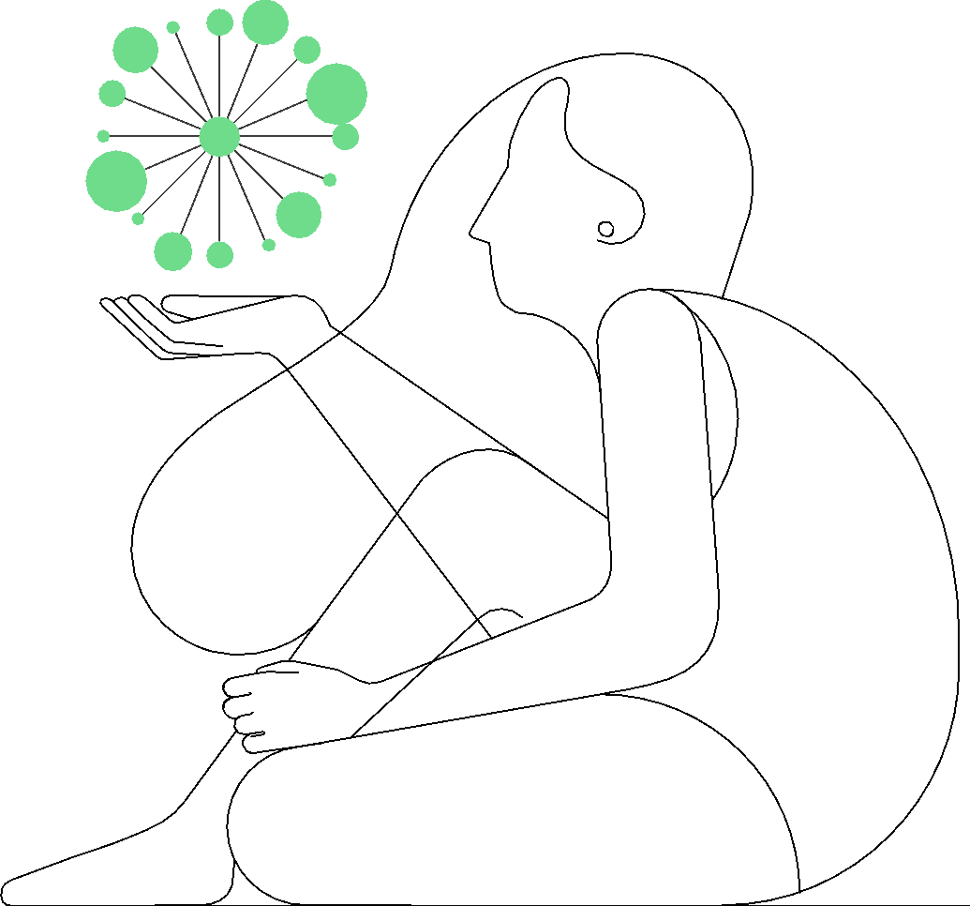
Accelerate Alumni: Words of Wisdom
“There is no limit to how much you can learn! Try new things, ask questions and really use this opportunity to grow and stand out! This experience. expedited my career growth and I hope the next cohort can enjoy the experience as much as I did!”
-Samantha H.
“Listen & be interactive in the sessions! Reach out to speakers you like to set up coffee chats and come prepared with questions!!”
-Sarah L.
“Take a deep breath, be involved, and network of course! The more you can get from this opportunity, the more you will grow and learn more professionally. Not only did I learn a lot through the consulting track, but I also got a feel for work-life balance.”
-Nicole D.
“Be a sponge to the information and share your personality! People will remember the person they connected with the most which is not necessarily the loudest person in the room. Find your people and the opportunities will follow you!”
-Trent B.
“Be engaged! It can be the first time you learn about your future role or career path.”
-Allen A.
“Seize every opportunity presented to you during the program. All of the optional and supplemental sessions are worth it. Sign up for everything, because you’ll meet awesome people at every turn.”
-Jasmine W.
“Network, network, network! Networking has helped me build more personal relationships rather than a one-time coffee chat.”
-Cuauhtemoc D.
“Listen critically & keep an open mind! I learned so much about an industry I thought myself to be experienced in. Take advantage of the wisdom of both your fellow Accelerate participants, and of course the incredible IBM mentors at your disposal.”
-Allison L.
IBM Accelerate 2024

Slide 28

Thank You! Next Track Skills Session: Wednesday, June 5th from 6-8 PM ET Next Foundational Skills Session: Monday, June 10th from 7-8 PM ET Mentorship & Networking See you then!

